Slide 1
Winning with an HSA

Slide 2
Winning with an HSA

Slide 3
Why HSAs?
Easy win in today’s complex health care system:
Save now:
Lower monthly insurance premiums
HSA deposits aren’t taxed
Typically lowers income tax liability
Save for the future:
HSA funds roll over from year to year
Tax-free interest earned
You keep the money even if you change jobs or insurance plans
“Best-in-class” investment options
You don’t have to change doctors

Slide 4
How an HSA works
Traditional health plan vs. HSA-powered health plan
Lower monthly premium
Higher deductible
Larger monthly premium paid to insurance company
Lower deductible
Money into savings account

Slide 5
How an HSA works
You and/or your employer
Your annual employer contributions*:
Individual: $750
Family: $1,500
$
$
Qualified medical expenses:
Exams, prescriptions, procedures, vision, dental and more
Notes:
BMC-HealthNet be contributing
$750= Individual
$1500= Family
The ER contributions will be available the beginning of the plan year.

Slide 6
Maximize your savings
2015 max contributions allowed by IRS:
Single-coverage: $3,350 (2014: $3,300)
Family-coverage: $6,650 (2014: $6,550)
Catch-up contribution, age 55+: $1,000
How to fund your HSA:
Best Practice: Make pretax contributions through payroll deductions
Contributions may also be made from other sources, such as a traditional checking or savings, to tax shelter the money and can be used on a pre-tax basis for future qualified medical expenses.

Slide 7
Who is eligible for an HSA?
To own an HSA, you need to:
Be covered ONLY by an HSA-qualified health plan
Other health coverage (including Medicare, a traditional health plan, or even an FSA) may disqualify you
Not be claimed as a dependent on someone else’s tax return

Slide 8
Powerful tools
Convenient access
Debit card
Online
Using our free HealthEquity mobile app
By telephone 24/7/365
Use your HealthEquity account to
Check your balance
Review transactions
Review claims
Submit new claims or documents
Send payments and reimbursements
Access tax documents

Slide 9
Investment platform
HealthEquity offers investment options for HSA holders with account balances above $2,000
There are no set-up or trading fees and no minimum investment requirements
Investment options, including a variety of mutual funds, are available through the HealthEquity online portal www.myhealthequity.com
Charles Schwab is HealthEquity’s partner for invested funds
Optional web based member- level investment resources available through HealthEquity Advisors
Earnings on investments accumulate tax-free
Notes:
Our group has been charged with finding ways to monetize the mutual fund side of the business such that HealthEquity becomes indifferent as to whether the participant chooses to keep their HSA in cash (banking instruments) or in mutual funds. We hope to be able to create margins on the investment side similar to what we currently enjoy on the banking side – and to do so while creating an exceptional platform and experience for the participant. If we can get there, HealthEquity will begin to campaign for people to move “excess accumulations” into mutual funds, and that would increase our Schwab holdings dramatically.
We are working on two initiatives to realize this objective. First, we are working to change our fund platform to be composed of demonstrably better performing funds that pay greater fees to HealthEquity. Second, we are completing a web-based advisory tool that will allow us to offer quality investment advice and implementation at a reasonable fee (AUM fee) for participants (participant level advice, not plan level) who choose to engage these tools – this side of the equation will be voluntary to the participant.

Slide 10
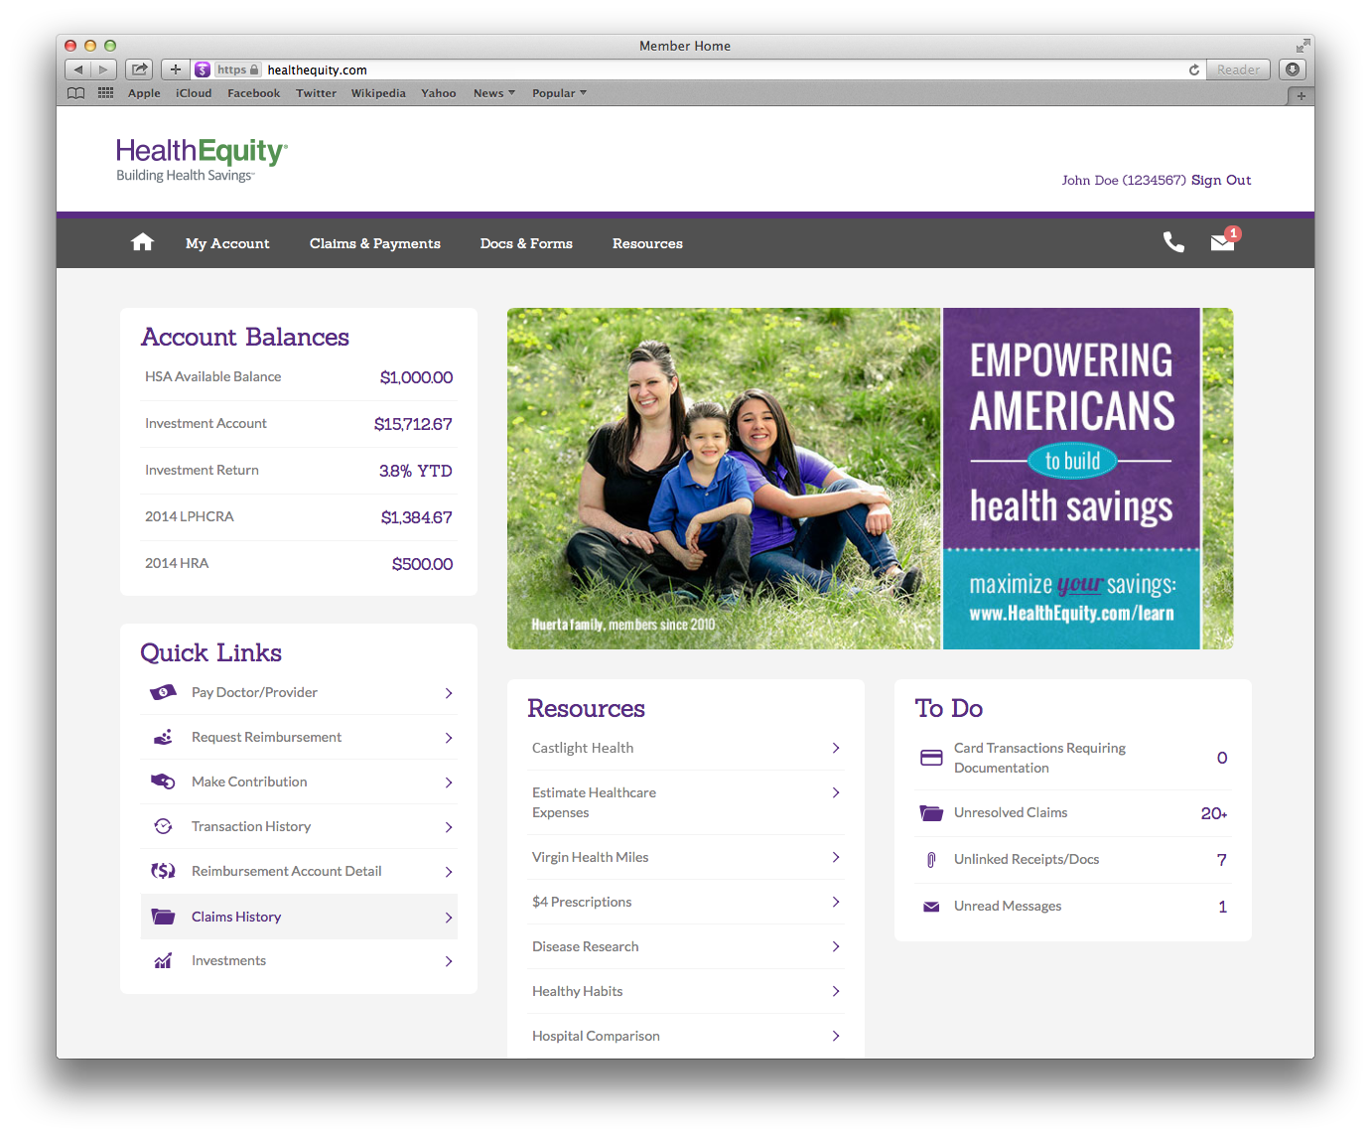
Notes:
It is key when introducing the demo to speak to why we organized the site the way we did, to give our members a simple web experience wit the ability to marry their health and wealth on one website. They should have easy access to their insurance information, their account balances, claims and tools to help them become better savers andd spenders. Should also highlight the "call us anytime" in the middle of the screen and the easily configuarable way we can brand (in this case for Adobe) and customize alerts and tools per our partners and members preferences.
Once the overview has been given (make sure the slides are in presentation mode) place the cursor on the "view claims" or "open claims" link and click to takee to the next slide that is the claim screen.

Slide 11
Options to fit your needs

Slide 12
Auto-pilot
Automatically implemented and
managed for you
Execution on advice
Rebalancing
Mutual fund rotation
Asset class rotation
Weekly performance summary (SEC Compliant)
Monitoring and alerting (emails, text messages)
Subscription based, cancel at anytime
Monthly fee .08% of invested balance ($.80 per $1000)

Slide 13
GPS
Guidance provided by Advisor, implemented by you
Recommended portfolio advice
Recommended rebalance
Recommended fund and asset class rotation
Weekly performance summary (SEC Compliant)
Monitoring & alerts (emails & texts)
Subscription-based, cancel at any time
Easy trade button
Monthly fee .05% of invested balance ($.50 per $1000)

Slide 14
Self-driven
No guidance provided,
directed by you
Access to HealthEquity’s best-in-class investment funds
42 funds to choose from
No fees on trading
Quarterly mutual fund report card
No monthly fee

Slide 15
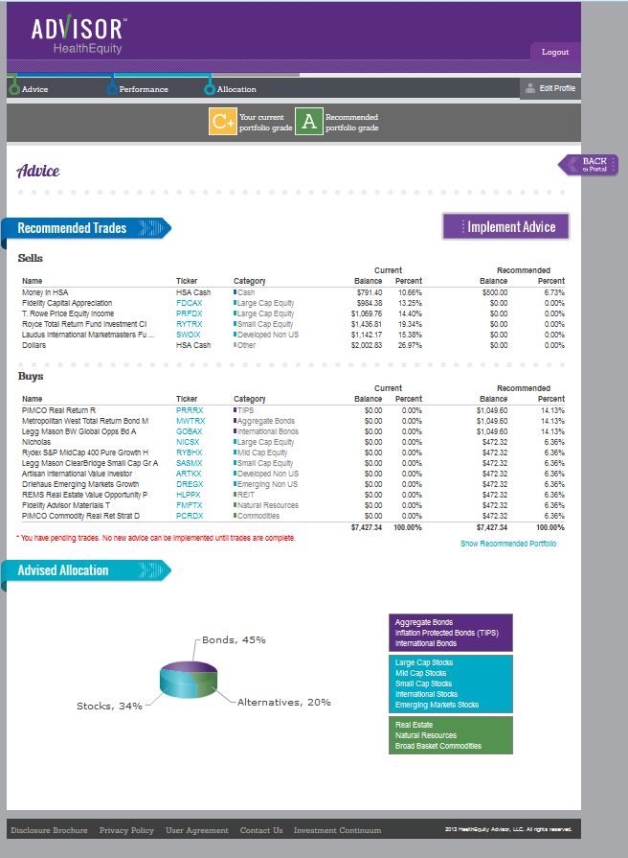
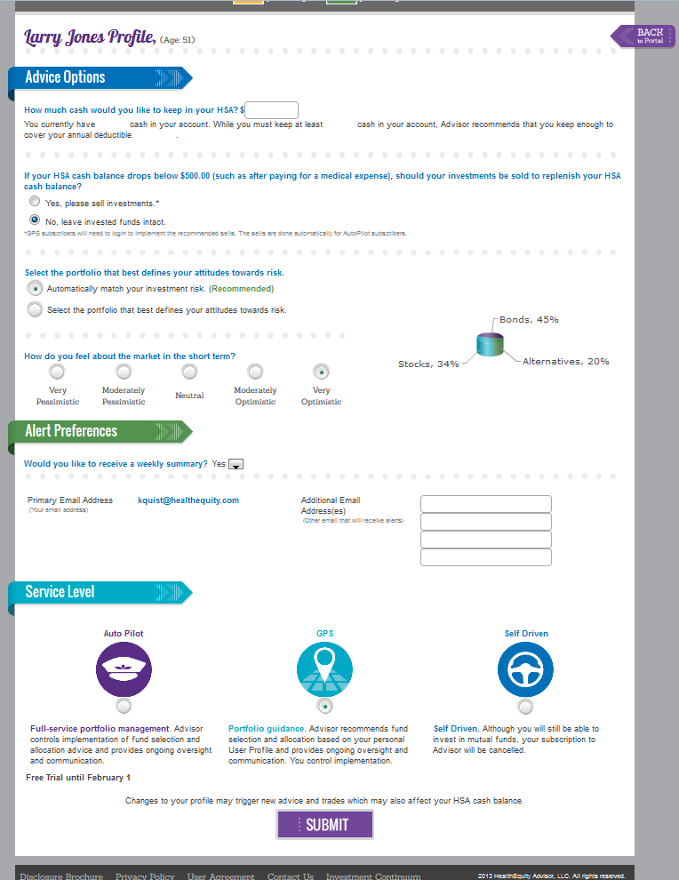
Easy, powerful online tools

Slide 16
Resources
www.healthequity.com/ed/hsalearn

Slide 17
FSAs: a simple way to save

Slide 18
Why FSAs?
A simple way to save:
Significant tax savings
Convenient payroll contributions
Easy to use payment options
Pay for qualified medical expenses or for qualified dependent care

Slide 19
Health care FSA
Pre-tax payroll contributions
Can be used to pay for qualified medical expenses
Entire fund amount available at the beginning of the plan year
IRS maximum contributions per family: $2500
Notes:
Speaker Notes:
Your employer may offer one or more types of FSAs, designed to maximize your savings and address your personal needs.

Slide 20
Limited-purpose FSA
Tax-free payroll contributions
Funds available up front at the beginning of the plan year
Used in conjunction with a health savings account (HSA)
Can be used for dental and/or vision expenses only
Allows you to maximize you pre-tax HSA contributions and contribute additional pre-tax dollars to your LPFSA up to $2,500.

Slide 21
Get started today!
Sign up
Each plan year during open enrollment
Choose election amount for the year (typically cannot change)
Contribute
Pre-tax through payroll
Amount withheld from your paycheck is typically equal each pay period
Use your funds
Pay with your HealthEquity debit card
Submit through the HealthEquity online tool for reimbursement
Remember to save ALL receipts

Slide 22
Use it or lose it
FSA funds do not roll over from year to year
You must use all FSA dollars within the plan year or forfeit them
Check with plan administrator for specific dates for reimbursements/ documentation

Slide 23
Introduction to your HRA

Slide 24
Why HRAs?
Save and win:
Coverage for out-of-pocket costs
You don’t pay taxes on HRA funds
Contributions are free money, provided by your employer. There are no payroll deductions

Slide 25
How HRAs work
Employer
Your annual employer contributions*:
Individual: $750
Family: $1,500
$
$
HRA
$
$
HRA will reimburse medical deductible expenses only
Notes:
Speaker Notes:
Your employer may offer one or more types of FSAs, designed to maximize your savings and address your personal needs.

Slide 26
Get started today!
Sign up
Enroll in the medical plan associated with your HRA
You will automatically be enrolled with the HRA
Use your funds
Your full HRA amount will be available for your use during the plan year
Eligible claims will be paid from your employer-funded account automatically.

Slide 27
Powerful tools
Convenient access
Online
Using our free mobile app
By telephone
Use your HealthEquity account to
Check your balance
Review transactions
Review claims
Submit new claims or documents

Slide 28
FSAs: a simple way to save

Slide 29
Why FSAs?
A simple way to save:
Significant tax savings
Convenient payroll contributions
Easy to use payment options
Pay for qualified medical expenses or for qualified dependent care

Slide 30
Health care FSA
Pre-tax payroll contributions
Can be used to pay for qualified medical expenses
Entire fund amount available at the beginning of the plan year
IRS maximum contributions per family: $2500
Notes:
Speaker Notes:
Your employer may offer one or more types of FSAs, designed to maximize your savings and address your personal needs.

Slide 31
Limited-purpose FSA
Tax-free payroll contributions
Funds available up front at the beginning of the plan year
Used in conjunction with a health savings account (HSA)
Can be used for dental and/or vision expenses only
Allows you to maximize you pre-tax HSA contributions and contribute additional pre-tax dollars to your LPFSA

Slide 32
Get started today!
Sign up
Each plan year during open enrollment
Choose election amount for the year (typically cannot change)
Contribute
Pre-tax through payroll
Amount withheld from your paycheck is typically equal each pay period
Use your funds
Pay with your HealthEquity debit card
Submit through the HealthEquity online tool for reimbursement
Remember to save ALL receipts

Slide 33
Use it or lose it
FSA funds do not roll over from year to year
You must use all FSA dollars within the plan year or forfeit them
BMC- HealthNet will provide a 90 day run-out period after close of the plan year (through March 31)to submit reimbursement requests for expenses incurred in the prior year.

Slide 34
Powerful tools
Convenient access
Debit card
Online
Using our free HealthEquity mobile app
By telephone 24/7/365
Use your HealthEquity account to
Check your balance
Review transactions
Review claims
Submit new claims or documents
Send payments and reimbursements
Access tax documents

Slide 35
Resources
www.healthequity.com/ed/fsalearn

Slide 36
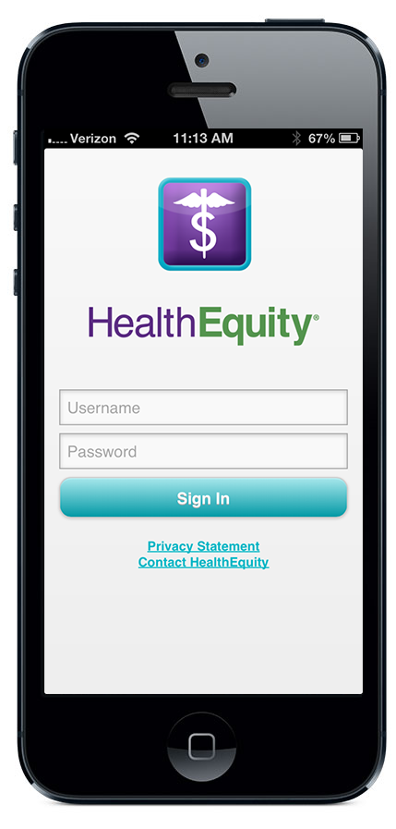
New HealthEquity mobile app
Convenient, powerful tools:
On-the-go access for all account types
Take a photo of documentation with phone and link to claims and payments
Send payments and reimbursements from HSA
Manage debit card transactions
View claims status
Available for iOS and Android

Slide 37
Expert friends
Always available Our member services are taking calls 24 hours a day, every day of the year
Every step along the way We are here to answer any questions you have and help you maximize your savings
Call today Let us conduct a personal assessment of your plan options
866.346.5800 www.healthequity.com
37

